Slide 1
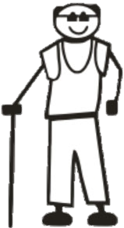
Help develop intergenerational relationships
Ask a child about their weekend sports/activity
Ask an adult about the best advice their parents gave them

Slide 2
Help develop intergenerational relationships
Ask a child about a school project they have completed recently
Ask an adult about the best place they’ve visited

Slide 3
Help develop intergenerational relationships
Ask a child about their favourite computer game
Ask an adult about what they do all day

Slide 4
Help develop intergenerational relationships
Share with someone from another generation what you like doing on holiday

