Slide 1

3
SPEAKING TRUTH TO POWER

Slide 2

QUAKER SAYING from the 18TH CENTURY
Was used by the Society of Friends in the 1950’s to speak out against America’s militarism . They attempted to speak to power in three senses:
‘To those who hold high places in our national life and
bear the terrible responsibility of making decisions for
war or peace’.
‘To the American people who are the final reservoir of
power in this country and whose values and expectations
set the limits for those who exercise authority.’
‘To the idea of Power itself, and its impact on Twentieth
Century life.’
‘Our truth is an ancient one: that love endures and overcomes; that hatred destroys; that what is obtained by love is retained, but what is obtained by hatred proves a burden’.
SPEAKING TRUTH TO POWER

Slide 3
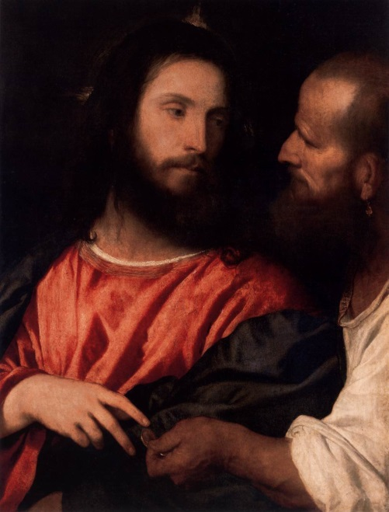
WHAT DOES CHRIST ASK of US?
❶
THE CHURCH v THE STATE
‘Therefore render to Caesar the things that are Caesar's, and to God the things that are God's:’
❷
ACTING MERCIFULLY & JUSTLY
‘Truly, I say to you, as you did it to one
of the least of these my brothers,
you did it to me.’
❸
WITNESSING THE TRUTH
‘So I strive always to keep my conscience clear before God and man
ACTS 24:16 - Paul’s testimony before the Governor at his trail
SPEAKING TRUTH TO POWER

Slide 4
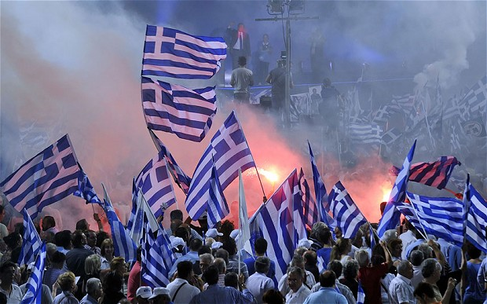
GREEK DEBT & GOVERNMENT CORRUPTION
Greece’s public debt is around 180% of its GDP - fresh tensions are emerging around assistance from outside agencies
The Greek Government misreported its financial problems – in 2009 it forecast deficits of around 6-8% of GDP - the result was almost 16%
SPEAKING TRUTH TO POWER

Slide 5
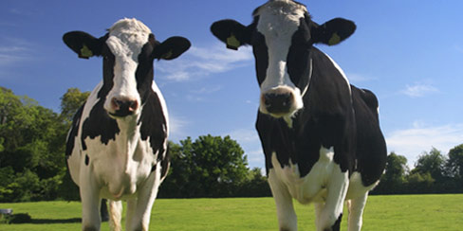
TWO COW JOKES
CAPITALISM - AMERICAN STYLE:
You have two cows. You sell one, buy a bull, and build a herd of cows
AN AMERICAN REPUBLICAN:
You have two cows. Your neighbour has none. So what?
GREEK CAPITALISM
You have two cows borrowed from French and German banks. You eat both of them. The banks call to collect their milk, but you cannot deliver so you call the IMF. The IMF loans you two cows. You eat both of them. The banks and the IMF call to collect their cows/milk. You are out getting a haircut.
SPEAKING TRUTH TO POWER

Slide 6
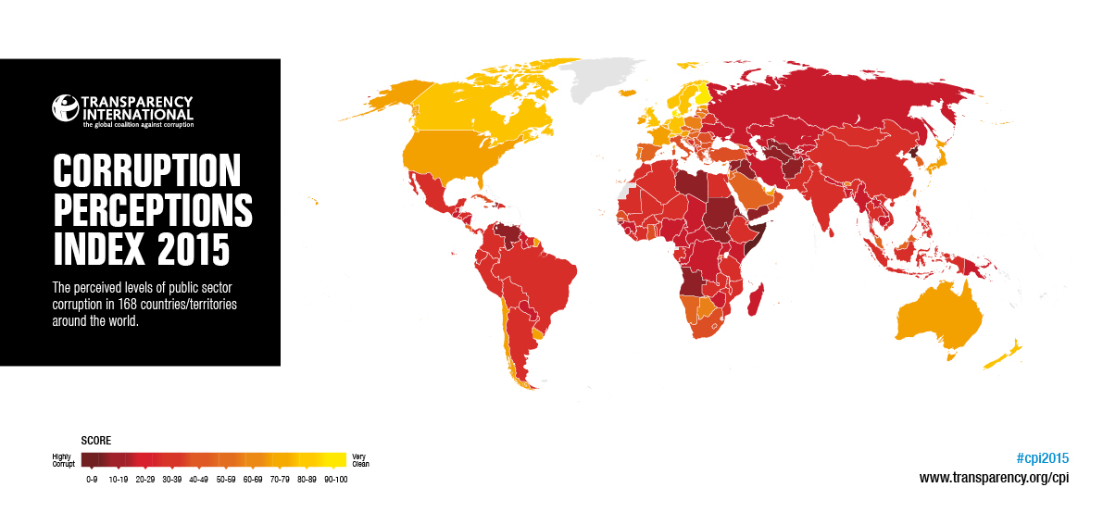
THE VALUE of BEING CORRUPTION-FREE
In 2015 Transparency International ranked NZ fourth in the world for being corruption free – this was down from 1st= in 2012
SPEAKING TRUTH TO POWER

Slide 7
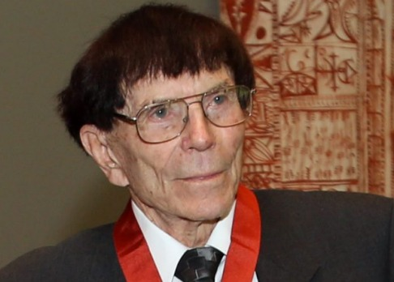
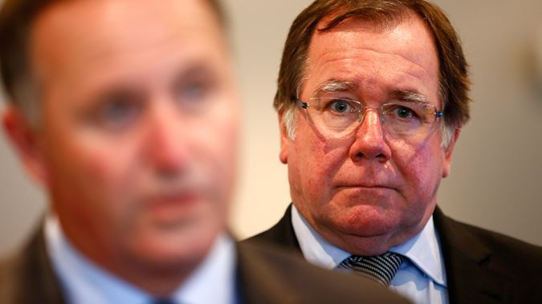
THE VALUE of BEING CORRUPTION-FREE
Earl Hagaman, an expatriate Californian businessman and founder of Scenic Hotel Group, gave $101,000 to National in September 2014. The following month the group said it had won the contract for the Matavai Resort on Niue, which is heavily funded by the New Zealand Government.
The commercial process for the
resort contract was handled by the
Niue Tourism Property Trust,
whose trustees are appointed by
Foreign Affairs Minister Murray
McCully. McCully says there is no
link between the donation and the
contract, nor the $7.5 million in
New Zealand aid funding announced a year later to expand the resort.
STUFF Editorial 19/04/16
SPEAKING TRUTH TO POWER

Slide 8
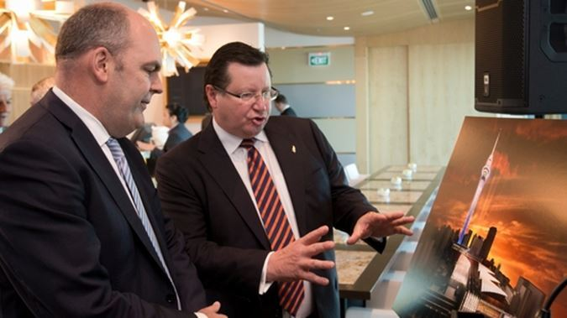
THE VALUE of BEING CORRUPTION-FREE
SkyCity CEO Nigel Morrison discusses the Auckland convention centre with Cabinet minister Steven Joyce in 2015
In 2013 Government agreed to increased gambling concessions to SkyCity casino in Auckland in exchange for SkyCity building a $400 million convention centre
This decision was made following a flawed bidding process which the Auditor-General said ‘fell short of good practice in a number of respects’
SPEAKING TRUTH TO POWER

Slide 9

EXPECTING ACCOUNTABILITY from GOVERNMENT
The 2016 State of the Nation report from The Salvation Army was framed as scepticism around the Government’s Better Public Service Targets
The analogy with a movable feast was made where we find any reason to celebrate success or progress even though we have lost our sense of the purpose behind it all.-
SPEAKING TRUTH TO POWER

Slide 10
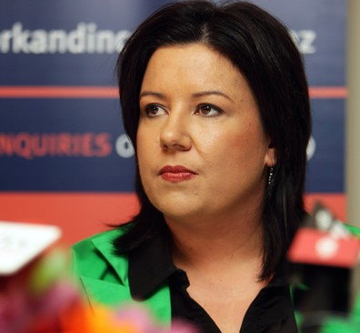
EXPECTING ACCOUNTABILITY from GOVERNMENT
When asked a question in Parliament about the prospect of having the Better Public Services target results scrutinised by the Office of the Auditor General, the Associate Finance Minister said
,
‘We do better than that; we get them scrutinised by the New Zealand public. We transparently put them out for them to be analysed by New Zealanders’
SPEAKING TRUTH TO POWER

Slide 11

BETTER PUBLIC SERVICE TARGETS
RESULT 4
Halt the rise in children experiencing physical abuse and reduce the current numbers by 5%
Ministry of Social Development report a 1.9% decline in the numbers of cases of substantiated physical abuse of children
From 3178 cases in 2013/14 to 3118 in 2014/15
SPEAKING TRUTH TO POWER

Slide 12
VIOLENT OFFENCES TOWARD CHILDREN 2014/15
Yet Police report more violent offences toward children than MSD can substantiate
In 2014/15 there were 4698 recorded assaults on 4170 individual children
SPEAKING TRUTH TO POWER

Slide 13


Reporting child abuse
Activity
‘Act early to protect children’
What/Action
‘Better reporting, easier ways to raise concerns, clarity on society’s expectations of parents, and advice on how to spot child abuse and neglect’
CHILDREN’S ACTION PLAN P.3
SPEAKING TRUTH TO POWER

Slide 14
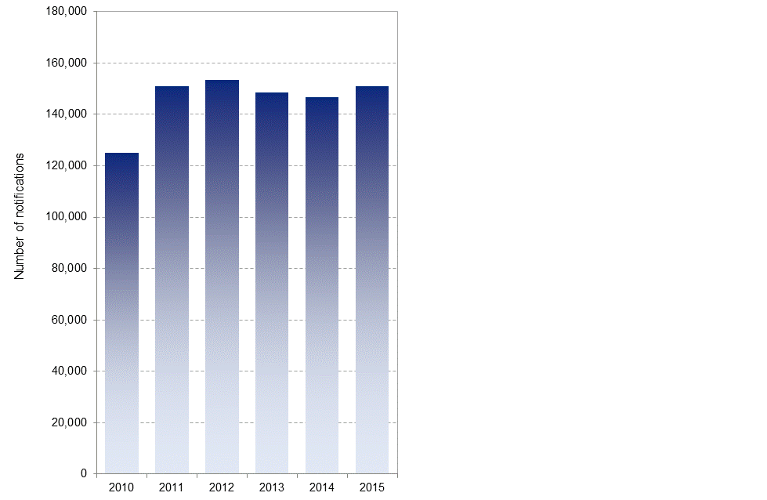
New Zealanders have responded positively to the Children’s Action Plan’s proposal to actively report possible child abuse or neglect
In 2014/15 CYF received 150,905 reports of possible child abuse/neglect up by 2,450 on the previous year
SPEAKING TRUTH TO POWER

Slide 15
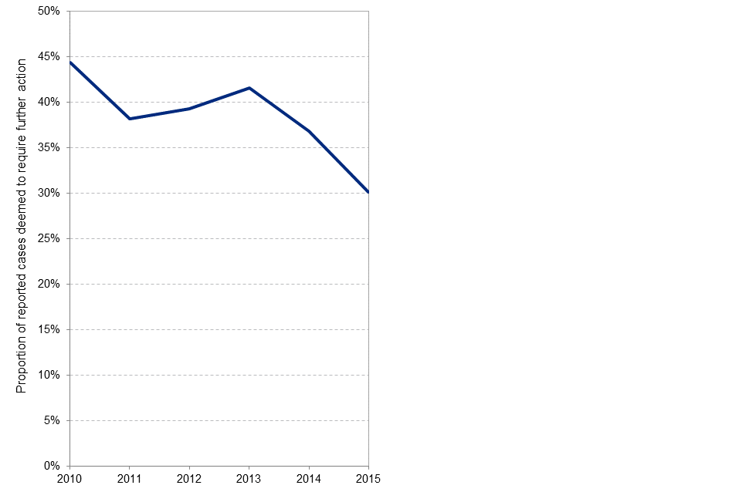
Yet CYF have decided to not to investigate a greater proportion of these reports
‘In 2014/2015, we strengthened practice by providing better screening at intake (so fewer cases unnecessarily proceed to an investigation or assessment), conducting more thorough assessments, and improving understanding of abuse findings.’
MSD 2014/14 ANNUAL REPORT P.22
SPEAKING TRUTH TO POWER

Slide 16
The number of substantiated cases of child abuse have fallen simply because CYF is placing less emphasis on emotional abuse and neglect
Child Youth & Family substantiations of child abuse and neglect - 2011 to 2015
Year ending 30 June 2011 2012 2013 2014 2015
Emotional abuse 12,711 12,454 12,777 10,406 8,318
Physical abuse 3,253 3,330 3,343 3,305 3,235
Sexual abuse 1,514 1,418 1,459 1,329 1,275
Neglect 4,813 4,970 5,405 4,583 3,644
Total substantiations 22,291 22,172 22,984 19,623 16,472
Source: Key Statistics from CFYs website at http://www.cyf.govt.nz/about-us/key-statistics/notifications.html
SPEAKING TRUTH TO POWER

Slide 17
KEY LESSONS
Targets have become mythical
- Reported outcomes have become symbolic and do not
entirely match historical facts
Practice is running contrary to declared strategy
- The Children’s Action Plan makes a big deal of active
public engagement while the results of this engagement are
increasingly ignored by CYF
Lack of transparency undermines credibility
- Having the agency responsible for the target outcome also
responsible for deciding practice, collecting and analysing
results and reporting outcomes risks making a joke of public
service targets
SPEAKING TRUTH TO POWER

Slide 18
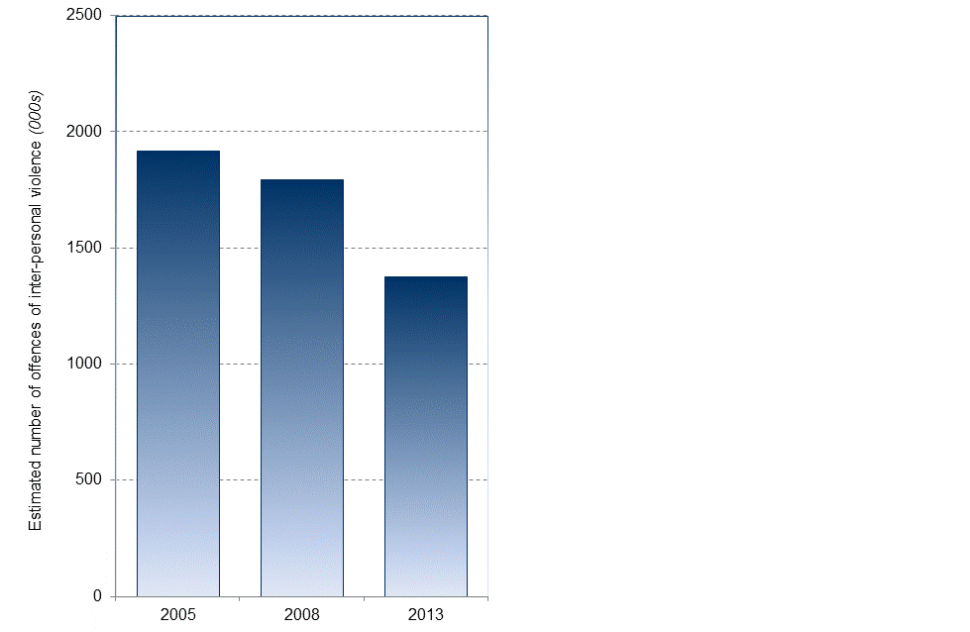
Violent crime has fell 23% between 2005 and 2013
NZ Crime & Safety Survey estimated that there was 1,379,000 violent offences in 2013 – down from 1,919,000 in 2005
SPEAKING TRUTH TO POWER

Slide 19
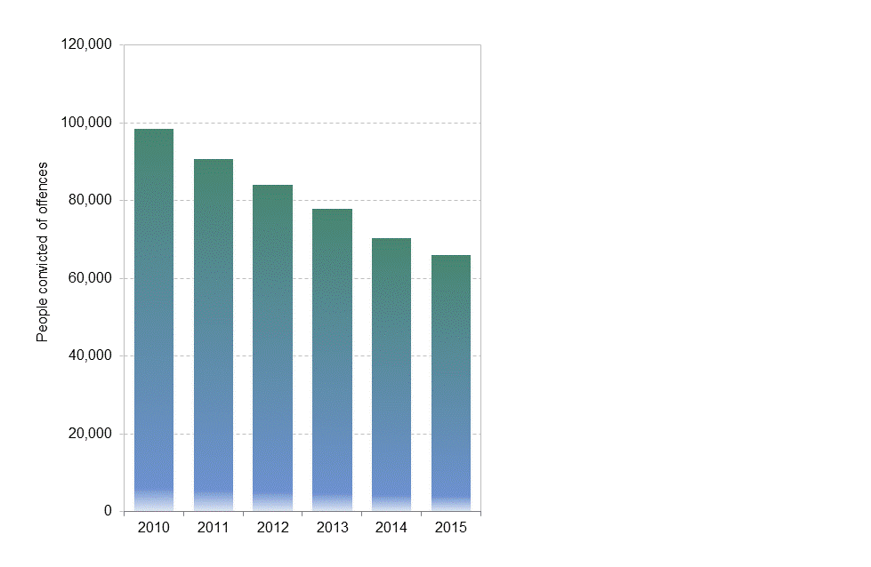
This fall in offending shows up in the numbers of adults convicted of offences
Between 2010 and 2015 – the number of people convicted fell by 1/3rd to 66,000
SPEAKING TRUTH TO POWER

Slide 20
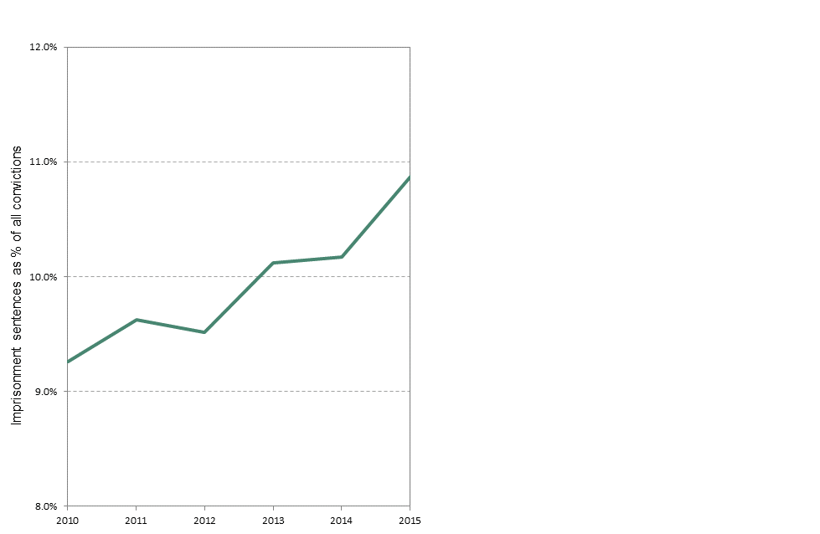
As the numbers being convicted have fallen in proportion of those convicted going to prison has risen
Between 2010 and 2015 – the proportion of adults convicted who went to prison rose consistently from 9.3% to 10.9%
SPEAKING TRUTH TO POWER

Slide 21
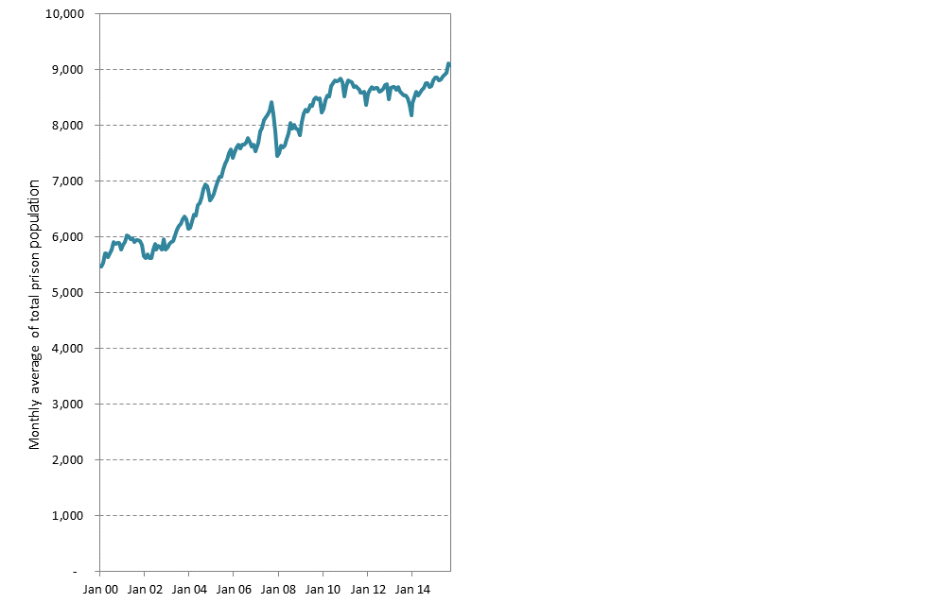
As a result prisoner numbers have continued to rise – now to record levels
In July 2015 the average monthly prisoner population exceeded 8,900 for the first time ever
SPEAKING TRUTH TO POWER

Slide 22
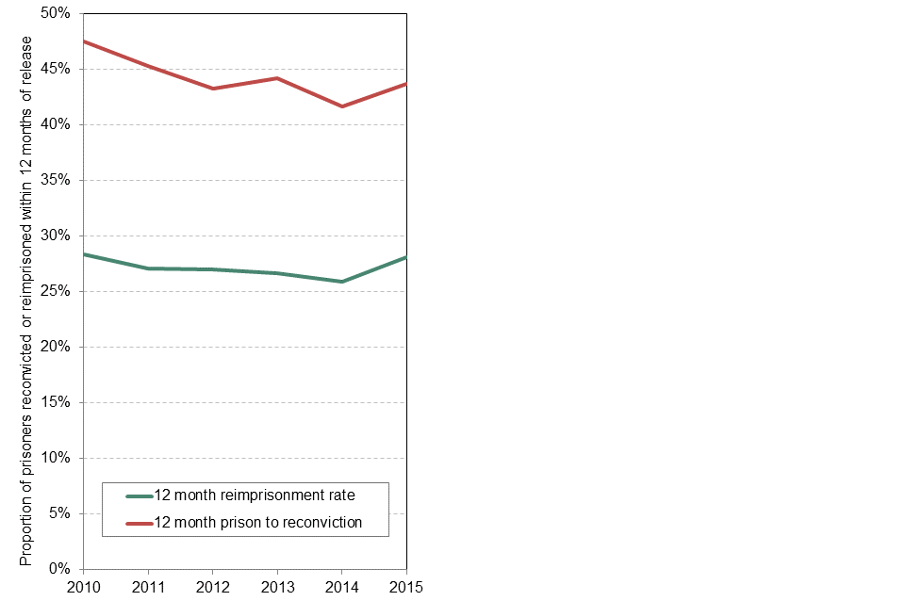
Despite the extra budgets & rhetoric, recidivism rates may be rising
Between 2013/14 and 2014/1 the 12 month release-reconviction rate rose 2% to 43.7% and the 12 month release-re-imprisonment rate 2.2% to 28.1%
SPEAKING TRUTH TO POWER

Slide 23
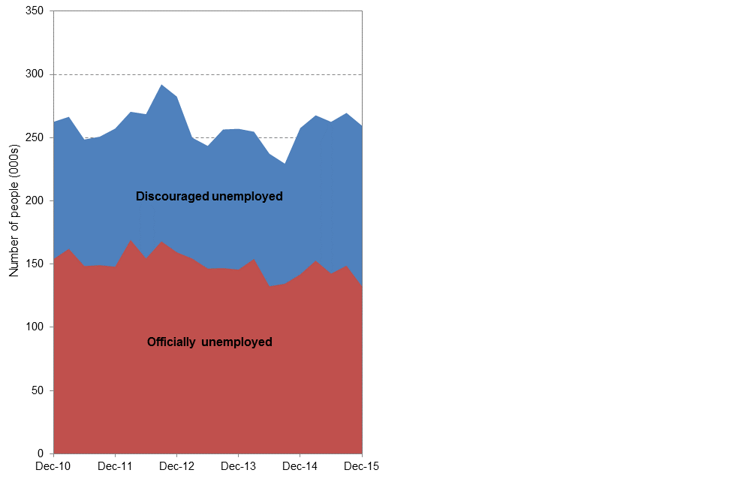
While job numbers have grown strongly over the past five years unemployment numbers have changed little
Consistently there have been around 150,000 people officially unemployed and a further 100,000 amongst the discouraged unemployed
SPEAKING TRUTH TO POWER

Slide 24
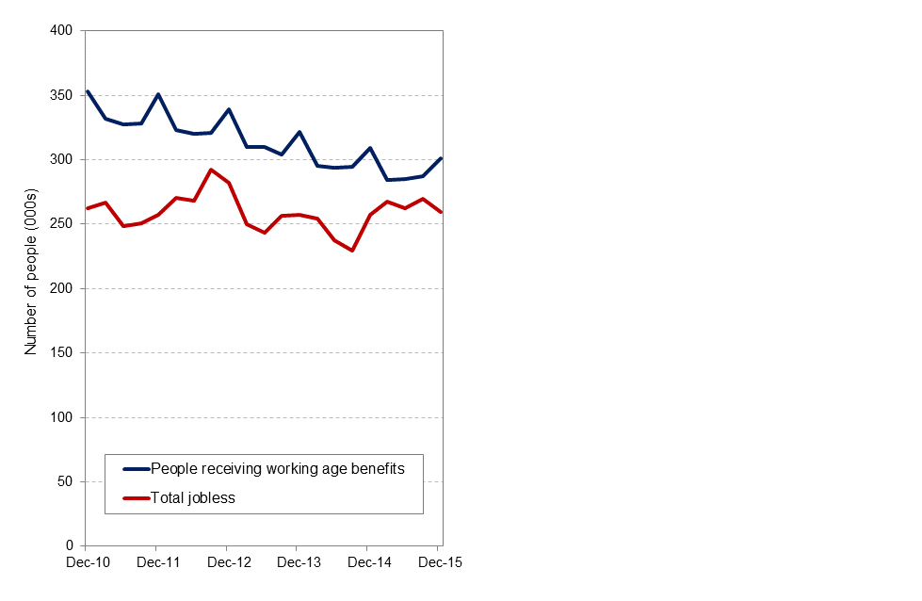
Despite these consistent unemployment numbers the number of people on benefits has dropped in line with Government’s tightening up access rules
Between 2010 and 2015 the number of people receiving working age benefits fell by 50,000 to 301,000 in December 2015
SPEAKING TRUTH TO POWER

Slide 25
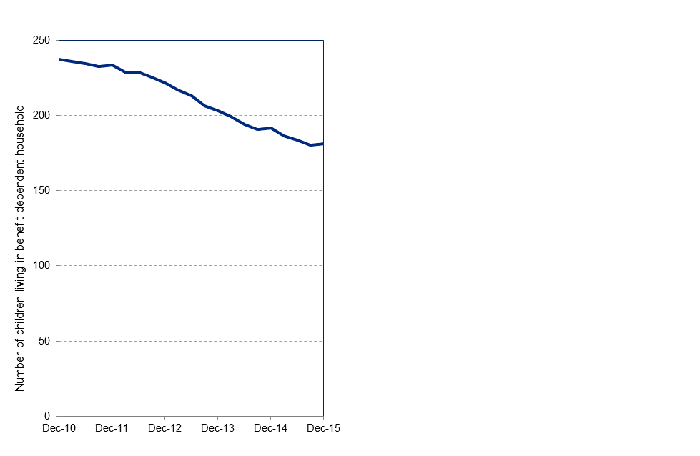
As benefit numbers have fallen so too have the numbers of children living in benefit dependent households
Between 2010 and 2015 the number of children in benefit dependent households dropped by 24% and by 55,000 to around 180,000
SPEAKING TRUTH TO POWER

Slide 26
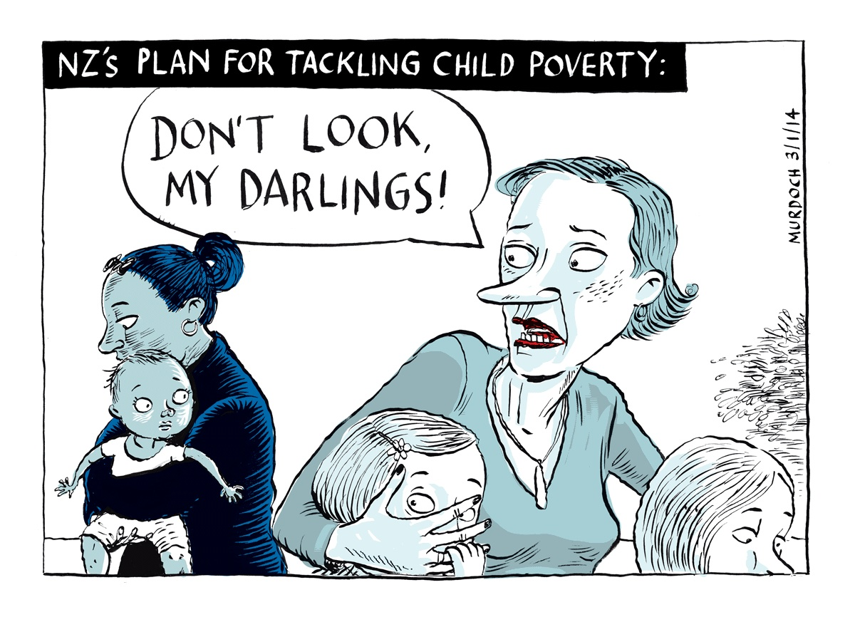
There has been no monitoring of how these changes have impacted on poor children and poor households so there is no evidence that the 100,000 people no longer on benefits are better or worse off
SPEAKING TRUTH TO POWER

Slide 27
Things to celebrate
- Falling teenage pregnancy rates
- Declining numbers of infant deaths
- Falling rates of youth offending
- Lower levels of violent offending
- Continuing job growth
- Continuing income growth
Things of concern
- Misuse of public service targets by Government agencies
- Lack of progress on reducing child poverty
- Absence of monitoring of effects of welfare policy changes
- The possible contagion of Auckland’s housing bubble
SPEAKING TRUTH TO POWER

